Slide 1
TASK #5.1
DESCRIPTION

Slide 2
Requirements
Python 3.8 (OOP knowledge)
Libraries: PyQt5, pymongo
Writing comments is a must!
Maybe one or two revisions.

Slide 3
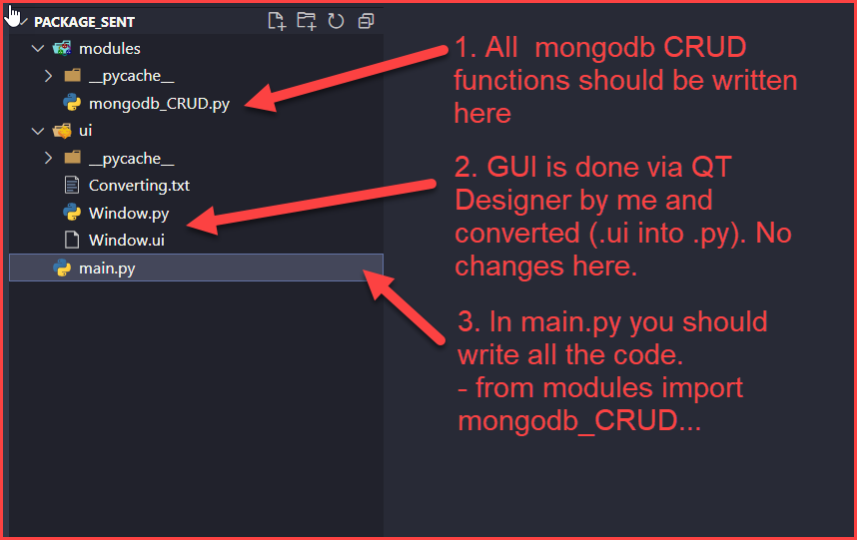
What will you get?

Slide 4
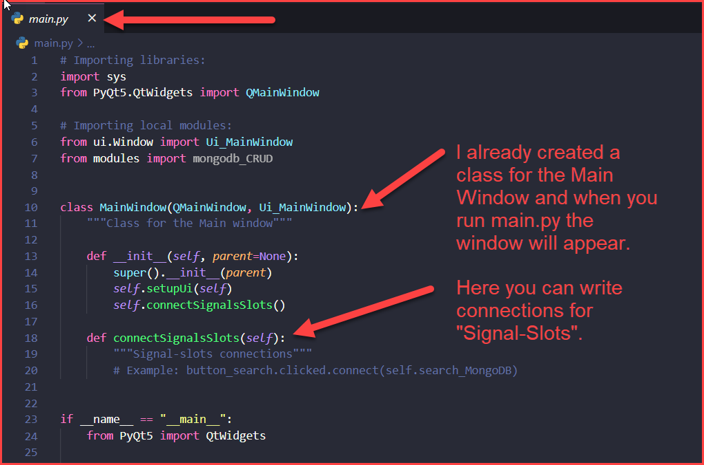
What will you get?

Slide 5
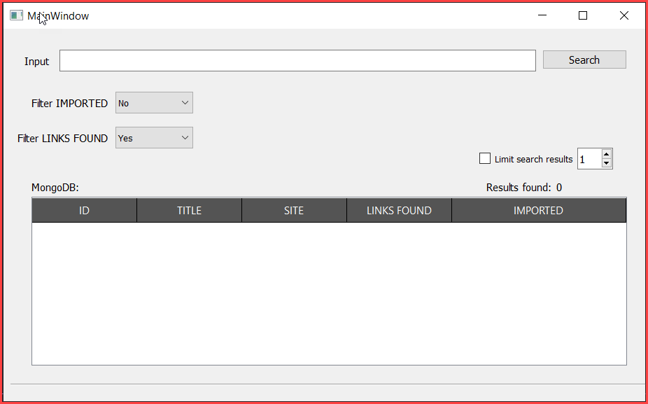
What will you get?
When you run main.py this window will appear.
GUI is done by myself. It’s very basic and we don’t need any change.
If you think that something needs to be changed, please let me know and I will change, or you can also do it, but only via Qt Designer, not manually in code.

Slide 6
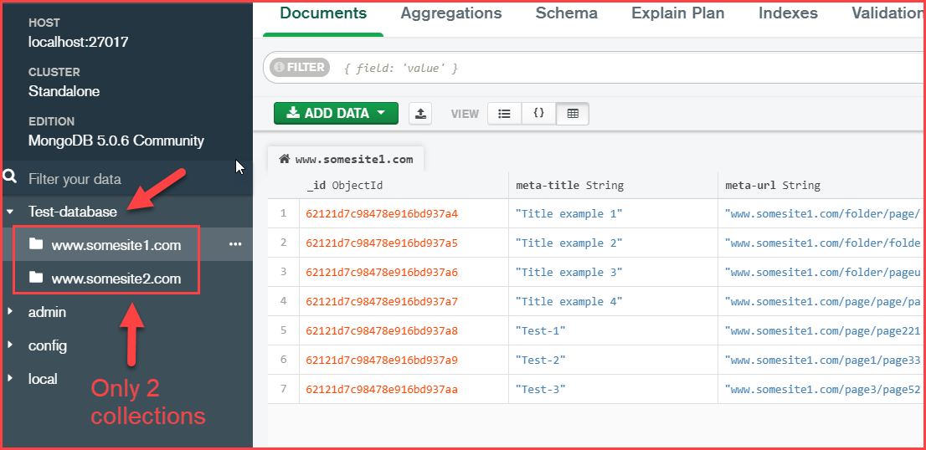
1. What needs to be done?
Mongodb is stored locally and I will also provide JSON with “example data” so you can import JSON into mongodb. There will be 2 collections made by my.

Slide 7
2. What needs to be done?
When we run main.py we should make a connection with local mongodb. (write function into mongodb_CRUD.py).
Also, you can make popup message “Connection is successful to local db” or some “ERROR:..”.

Slide 8
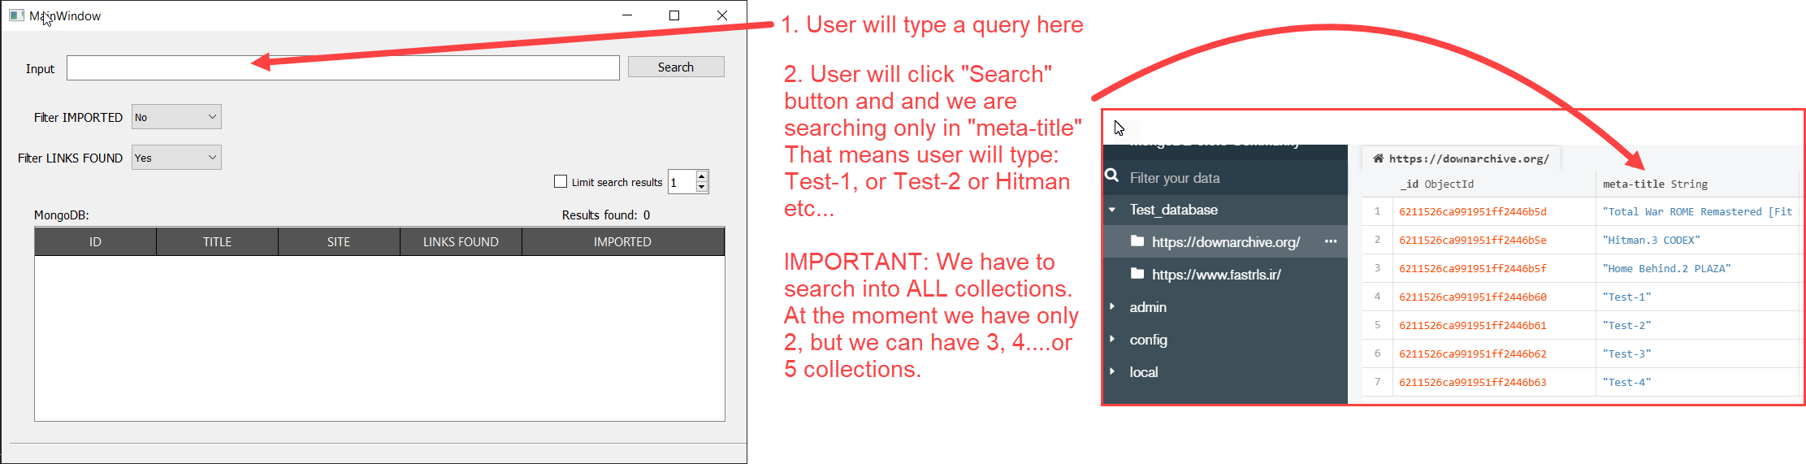
3. What needs to be done?
Reference: search through all collections of a database in Mongodb (python)
Ask Question ← This reference could be usefull

Slide 9
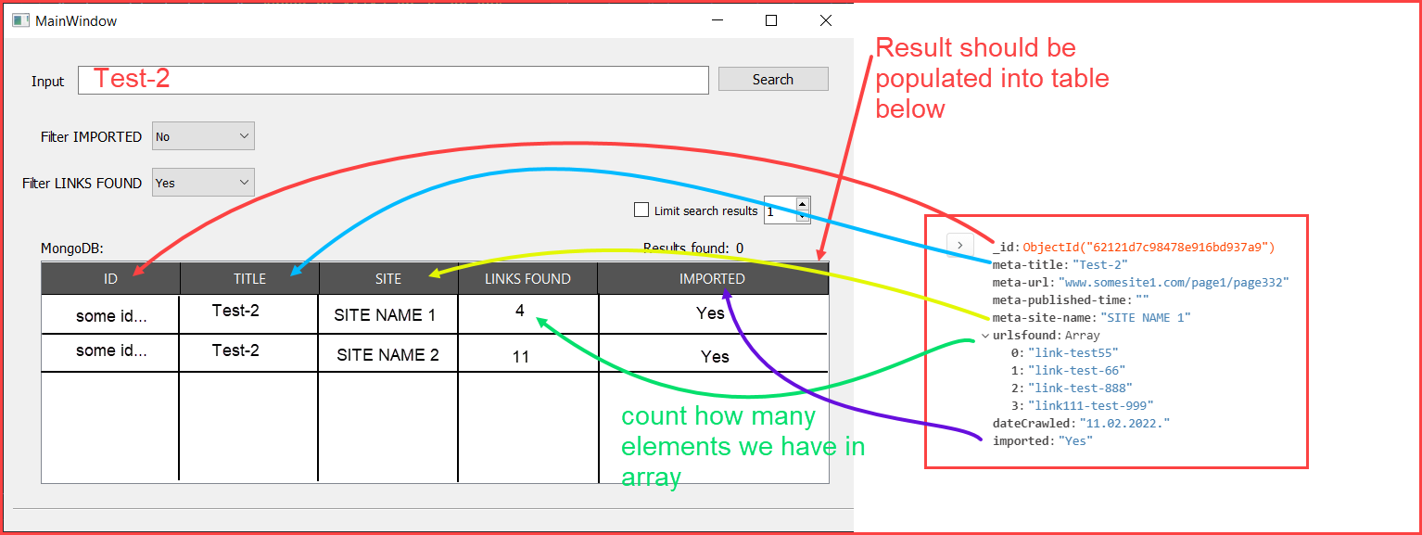
4. What needs to be done?
Result should be populated into table. Example below:

Slide 10
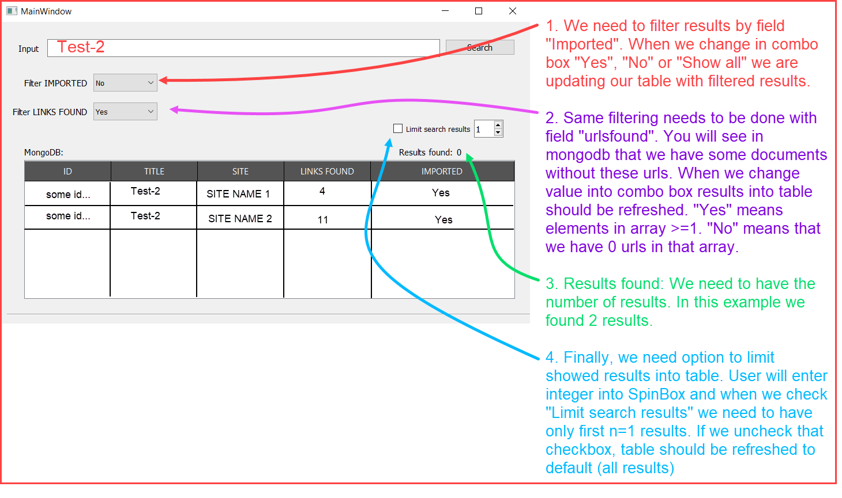
5. What needs to be done?
We need to have possibility for filtering results:

Slide 11
6. Final words
That’s all for this task 5.1.
Task 5.2 will be continuation of this task. It will include some scraping via Selenium (or Scrapy + Splash) and coping some results into SQL database. I haven’t prepare this task at the moment of writing. I have to design those databases at first and then we will continue.

